Slide 1
RGB in Clinical Practice
To ply or not to ply, that is the question! ; )

Slide 2
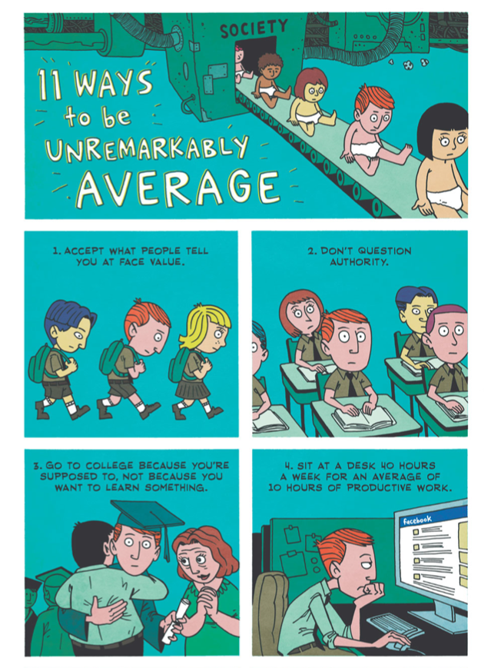
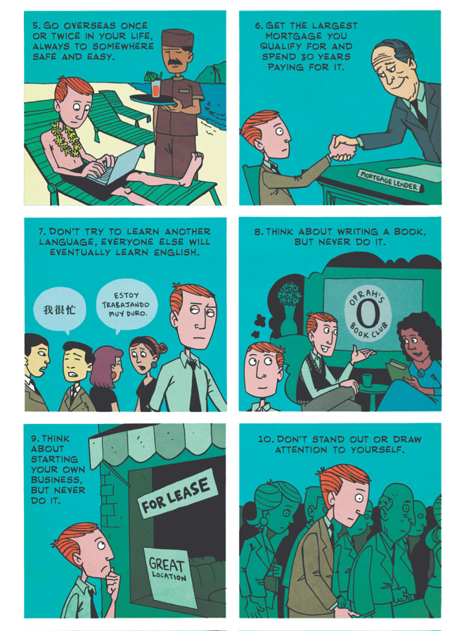

Slide 3
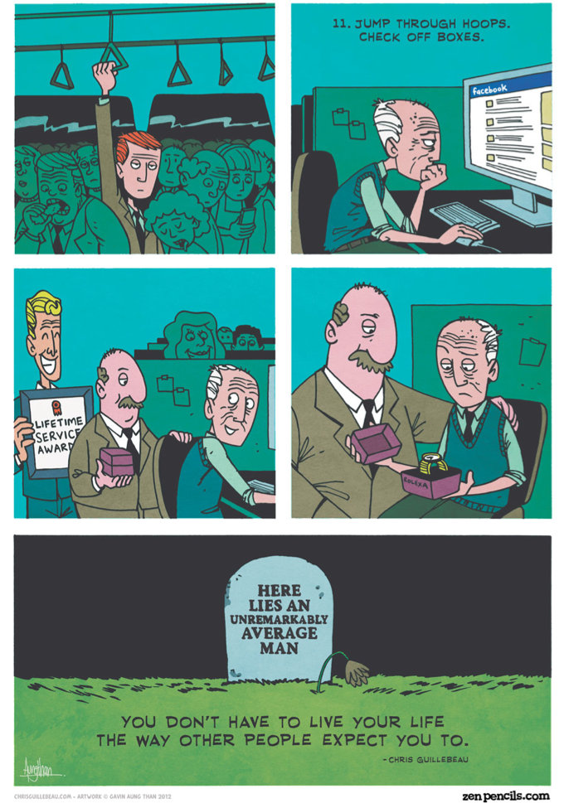

Slide 4
What are rules?
you know this!
its happening right now.....
Notes:
You know this - you’re doing it right now!
* sitting down, not speaking, no one playing basketball, no one talking
My self-rules - i’m going to screw up and embarrass myself...

Slide 5
RFT basics
a behaviour analytic approach to language and cognitive functioning
it explains these phenomena as arbitrarily applicable relational responding (relational framing)
verbally able humans can respond to:
formal/physical relations between objects
arbitrary contextual and social cues
Notes:
AARR is provides the basic units of human language and cognition
AA re in some contexts this response is under the control of cues based on social whim

Slide 6
Reminders
we have a learning history - both direct and derived
importance of context - contexts are the focus of clinical interventions in ACT
Notes:
rule following depends on these things

Slide 7
Self & Other
Rules provided by other people - socially mediated
Self-rules

Slide 8
3 kinds of RGB
rule governed behaviour is the essential human behaviour
pliance (simple)
tracking
augmenting (complex)

Slide 9
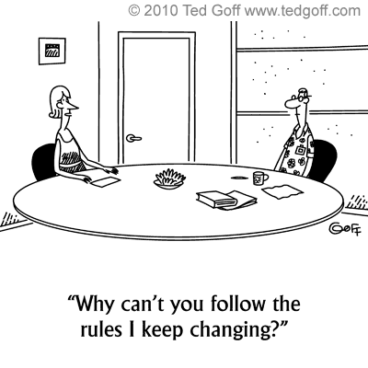
Pliance
following a rule in order to please or displease someone
socially monitored
e.g. self-rules: “if I agree, he will approve of me”
wear your coat!
following rules to please others
I need to do what I am told

Slide 10
Pliance
LEARNING HISTORY | rule stated socially mediated consequences history of following the rules
CURRENT CONTEXT | follow a rule because a person said X will happen obtain favour, avoid punishment
Notes:
Could also be a group - government rules, rules in this room, belonging to a particular group of people

Slide 11
Pliance
Helpful:
promotes behaviour controlled by long term consequences
easy to learn rules
quick and efficient
get along with others
Unhelpful:
pleasing others (seeking reinforcers, avoiding punishers)
counter-pliance - doing the opposite
rigid & inflexible
areas of experience are blocked
Notes:
bloked - e.g. going to museum cos thats what intellectuals do, without actually enjoying the experience.
With generalised pliance, the path to tracking is hindered

Slide 12
Pliance in therapy
client tries to please the therapist, look good, be right in the eyes of others
counter-pliance (resistance) by the client
same goes for the therapist!
Notes:
Who here provides rules to their clients? (everyone should put up their hand)
What rules do you have for yourself in session?
What would happen to a client who simply followed the rules you provided blindingly?

Slide 13
If the map doesn’t agree with the ground, the map is wrong

Slide 14
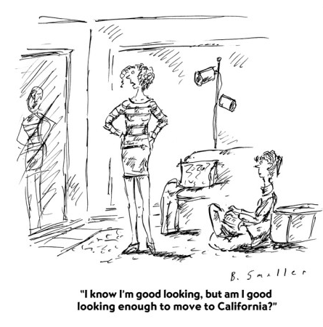
Tracking (tracking a rule)
what can I do to get reinforcers?
puts us into direct contact with the impact of behaviour
e.g. wearing a coat because you want to keep warm
Notes:
Pliance sets the stage for tracking in child development

Slide 15
Tracking
LEARNING HISTORY | once pliance is practiced, tracking usually follows carrying out the rule is followed by natural reinforcers
CURRENT CONTEXT | follow a rule observe natural changes does this fit with what is happening in the world around me?
Notes:
Could also be a group - government rules, rules in this room, belonging to a particular group of people

Slide 16
Tracking
Helpful:
tracking goes beyond trying to please or displease others
check I’m on the right path
adapt to the environment rather than merely bending social whim
does the rule work for me in this context
Unhelpful:
focus on immediate consequences (e.g. drugs reduce anxiety) rather than long term consequences
track untested rules
tracking rules in the wrong context
track is inaccurate
Notes:
Track is inaccurate - rule-following does not lead to the specified consequence
e.g. quitting smoking does not involve any discomfort
Effective tracking in the short run may not be helpful in the long run

Slide 17
Tracking in therapy
i can’t go out because i’ll feel very anxious - track the short term consequence of not feeling social anxiety upon staying home
self-confirm the rule ‘I am hopeless’ in therapy
sticking to rules that don’t work regardless of the context
self-confirm the ‘I’m an incompetent therapist’ rule
enhance flexibility in tracking rules
Notes:
I am a hopeless therapist

Slide 18
Curious?

Slide 19
Augmenting
connected to pliance and tracking (interacts)
does not specify consequences like plys or tracks
verbally formulated incentives
what we commonly call ‘motivation’

Slide 20
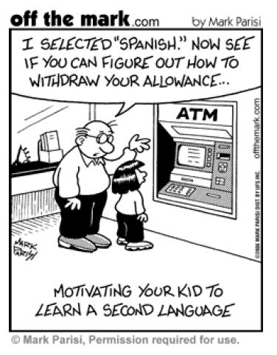
Augmenting
Formative - establish new consequences
e.g. if hearing the word good is reinforcing, then learning that the word bon also means good can establish it as a reinforcer as well

Slide 21
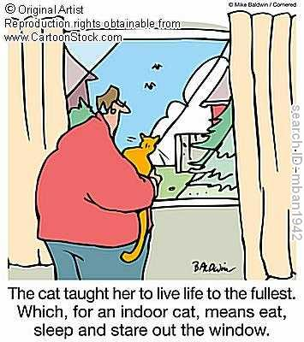
Augmenting
Motivative - increases the reinforcing value of something that is already reinforcing
values - chief source of motivation in adults
e.g. eat vegetables to be a big strong boy; how want to be a loving partner
Notes:
Augment - make something greater by adding to it; to increase
Highlight the importance of what we want to do

Slide 22
Augmenting
Helpful:
put us into contact with things we value in life
ethical and moral behaviour
gives flexibility to rule following
put us in contact with new and helpful consequences
Unhelpful:
insensitivity to changing contingencies can increase
linked to abstract or remote consequences
can interfere with effective valued actions
Notes:
more insensitivity - harder to direct consequences to affect behaviour

Slide 23
Augmenting in therapy
pliance and augmenting can interact - e.g. “I need to be a lovable person” may be established as an ultimate reward
I want to live a life full of vitality. In order to do so I must think through/solve my depressive thoughts. Then I will feel happy, and I can get on with things
I want to be a wonderfully supportive and empathic therapist, so I need to please my clients any way I can
values

Slide 24
Summary
from ‘Learning RFT’
pliance - you seek what the rule giver holds in her hand
tracking - you seek whatever is on the map
augmenting - you seek consequences based on the value you assign them

Slide 25
Rules for flexibility
learn rapidly, with precision, and effectively
can apply rules in vastly different situations to the one in which it was presented
avoid dangerous, potentially lethal situations
delay and reduce impulsivity
deal with problems ahead of time
use verbal strategies to respond to ambiguity
self-knowledge (monitor and awareness)

Slide 26
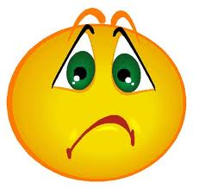
Rules understood, not followed...
knowledge does not equal behaviour change
Why?

Slide 27
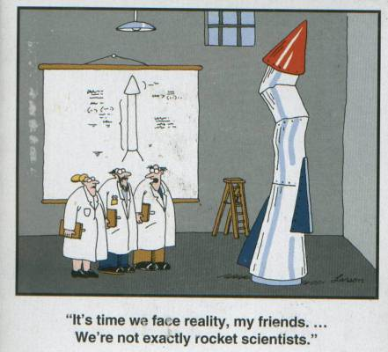
Don’t have the skills required to follow the rule

Slide 28
Credibility of the speaker
would you act on advice from this man?!

Slide 29
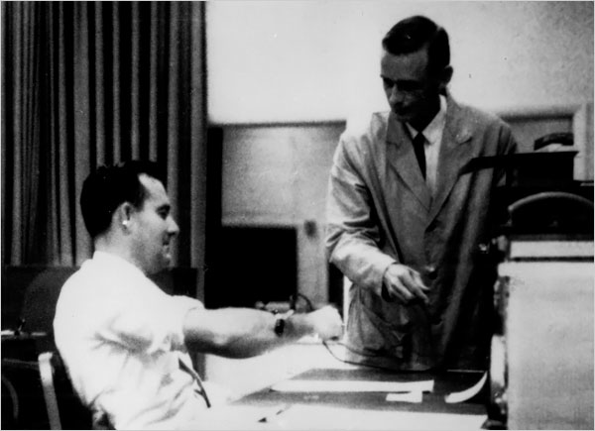
authority and ability to mediate reinforcement

Slide 30
plausibility of the rule

Slide 31
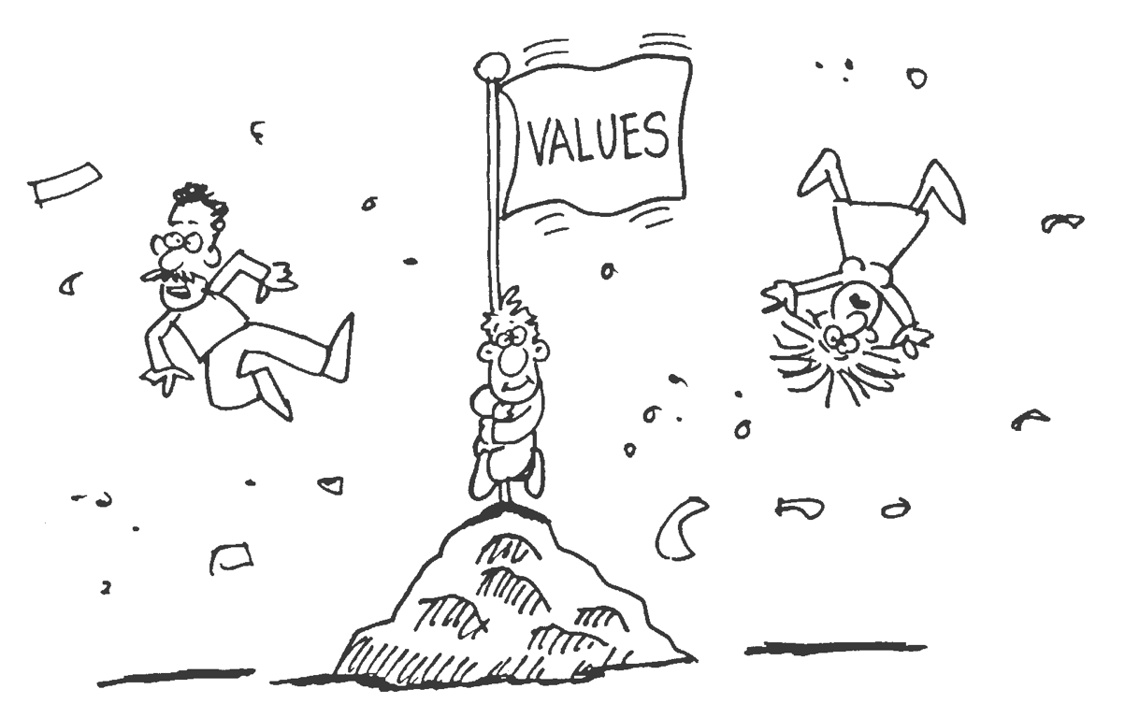
asked to do something that doesn’t fit with values

Slide 32
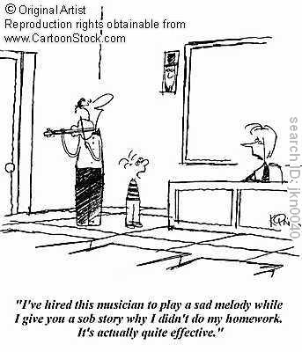
RFT and Persuasion

Slide 33
Nobody likes to be told what to do

Slide 34
Verbal relations are only amplified by verbal attack
verbal relations are additive not subtractive - no delete button!

Slide 35
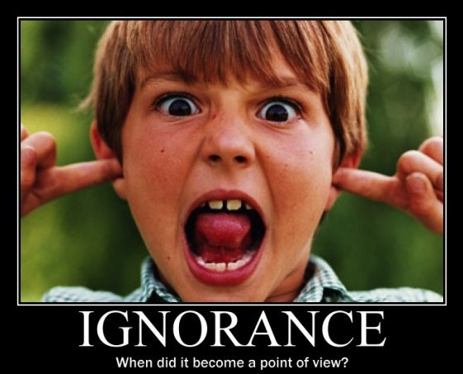
verbal rules often induce insensitivity to direct consequences
Notes:
Try and persuade but the person ain’t listening!

Slide 36
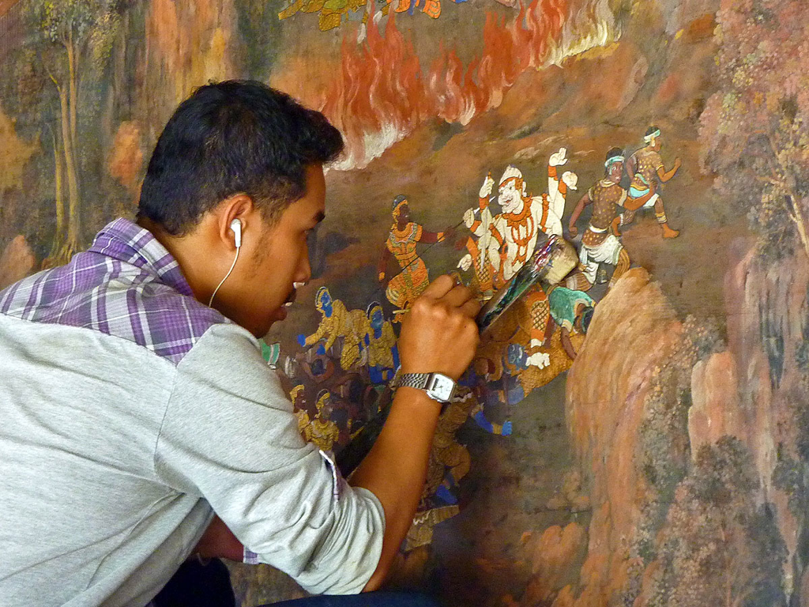
Change verbal relations by adding new ones
this expands the network - much easier this way!

Slide 37
RFT to ACT
aim is not to argue or try to impart more rules
aim is to undermine excessive rule control so the client can come into contact with natural and social reinforcers

Slide 38
RFT to ACT
focus is on motivative augmental control
promoting adaptive rules

Slide 39
RFT to ACT
acting in accordance with values involves rules
ACT is not against rule following behaviour
suggests that we respond to rules in a more flexible way, and that we track rules that tend to make future psychological flexibility more likely

Slide 40
“RFT is a contextual theory, and contexts are the focus of clinical interventions in ACT”
“The ultimate goal of ACT is to bring verbal cognitive processes under better contextual control and to have the client spend more time in contact with the positive consequences of his or her actions immediately in the present as part of a valued life path”

